Slide 1

Examples
What kind of shops do you think we see nowadays?
- Bakery
-Clothes Shops
-Pet Shop
-Cafe shop

Slide 2
More examples
Electronic store
Barber’s
Butcher’s
Greengrocer’s
Newsagent’s
Sports shop
Florist’s
Confectionery
Stationery
Gift shop
Bookshop
Pharmacy
Shoeshop
Music shop
Wineshop
Tobacconist’s
Car dealership
Garage
Paint shop
Toy shop
Jeweller’s
Boutique

Slide 3
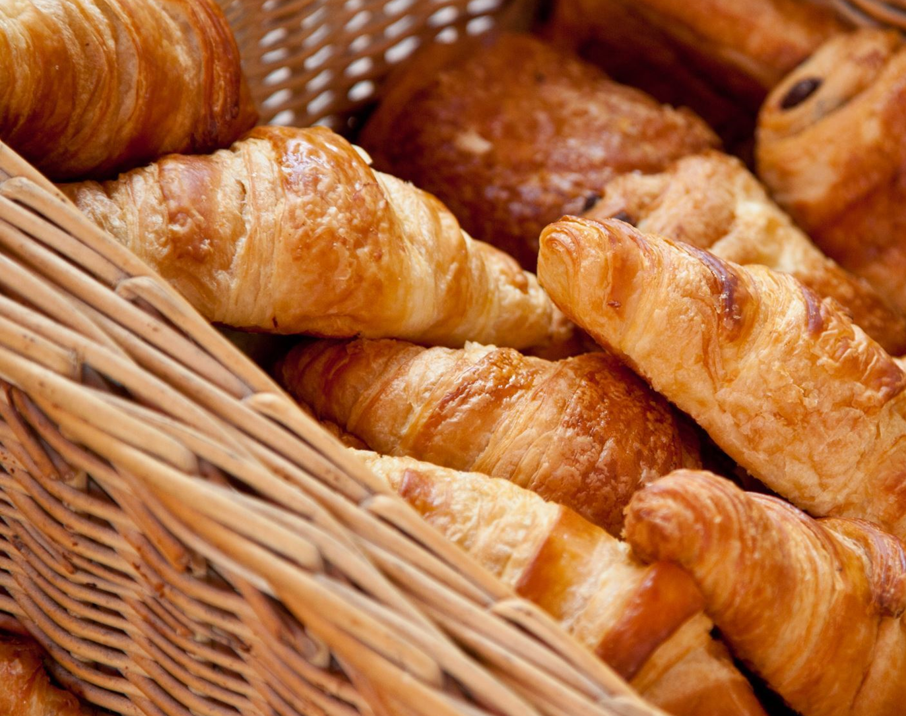
Bakery
Fresh and High-Quality Products
Community Connection
Customization

Slide 4

Clothes Store
Fashion Trends
Fitting Rooms
Try Before You Buy

Slide 5

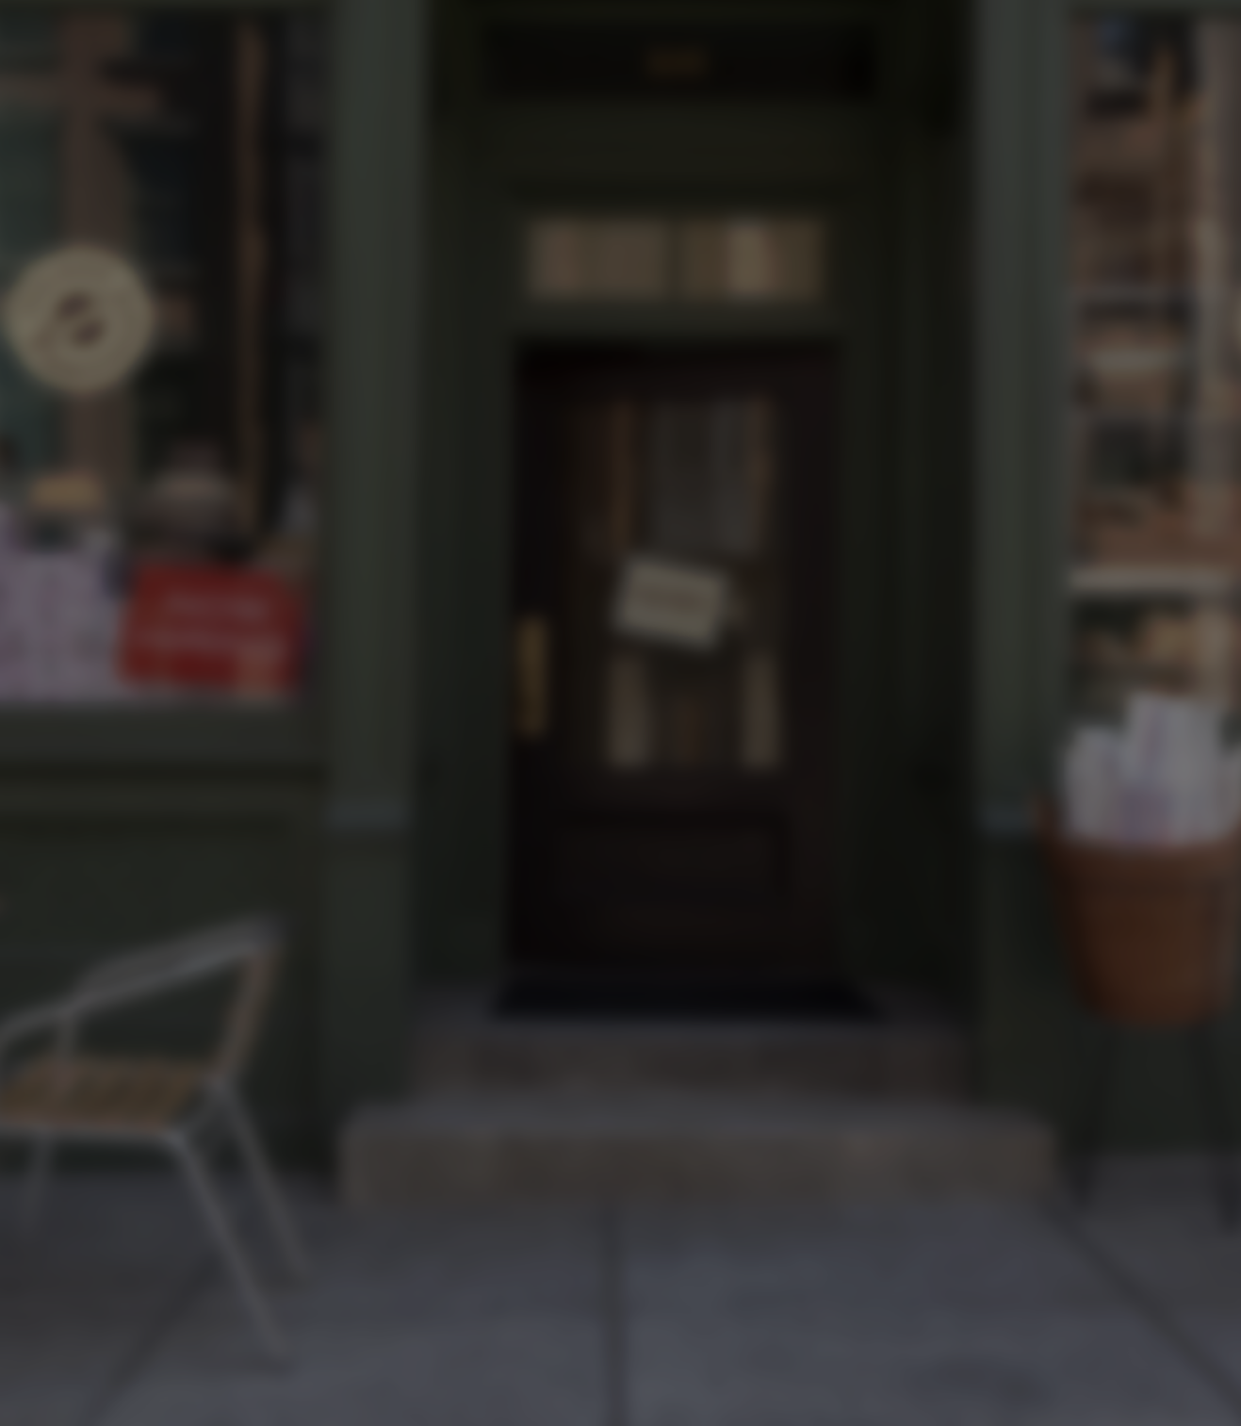
Advantages
Shopping Centre ->Plenty of Parking
-> Self-checkout
-> long opening hours
-> home delivery -> Special Events and Promotions (eg. Sales, black Friday, fashion shows, charity events) -> Security and Safety -> Community Hub (cinema, cafe, restaurants, bowling alley)
Small Shop -> Adaptation to Customer Feedback (meet customers’s needs) -> Less Overhead (less rental fees) -> Personalized Service -> Community Connection
-> Friendlier staff
-> less crowded
-> closer to your home

Slide 6
Disadvantages
Shopping Centre -> Impersonal Atmosphere -> Parking Challenges -> High Overhead Costs -> Crowded and Noisy
-> buying unnecessary products
-> long queues
Small Shop -> Limited Product Selection -> Limited Opening Hours -> Dependency on Local Economy -> Technology and E-commerce Challenges (no applications, no sales)

